Slide 1
Midterm Presentation - P4 Accuracy of Approximate Circuits
Fabian Garber, Simon Howind, Kagan Özten, Martin Resetarits, Peter Traunmüller
Notes:
Hallo everybody and welcome to our presentation. We are going to present the topic P4 Accuracy of Approximate Circuits

Slide 2
Introduction
Short Recap
Binary Decision Diagram Progress / Error Analysis
VHDL Progress
Power & Area Analysis
Outlook
2/
Notes:
I would like to start with a small introduction about approximate computing and its advantages compared to conventional circuits.
According to multiple papers, it has shown to be one of the most promising energy-efficient paradigms and has therefore reached a lot of research attention.
Another advantage of the approximate circuits is that the hardware uses less space due to the reduced number of logic gates.
For the same reason it has a reduced delay time and produces faster results.

Slide 3
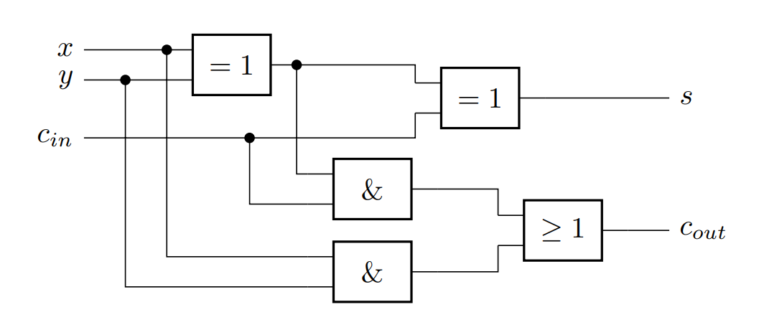
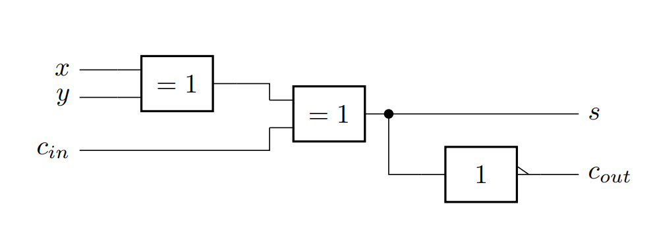
Recap: Circuit Designs
Conventional Full Adder Circuit Design
Approximate Full Adder Circuit Design as proposed by Priyadharshni et al
3/
Notes:
The first design is an exact adder and the second one is an approximate design taken from a paper.
As you can clearly see, the second one is „missing“ some logic gates. The approximate circuit utilizes only 2 exclusive OR's and one NOT gate. The delay is created by three logic gates although the last one is a NOT and much faster than the other gates.
To see what effect it has on the results, we will take a look at the truth tables.

Slide 4
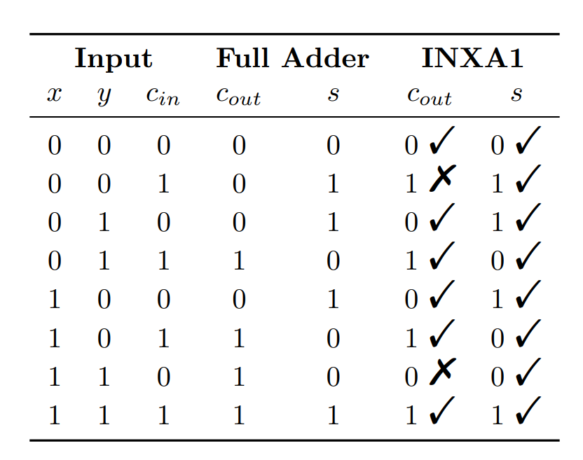
Recap: Truth Table
4/
Notes:
In this chart the tick marks show a correct result, and the crosses indicate a wrong bit.
As we can see the sum is always calculated correctly.
However, deviations occur, when calculating the carry out.
Therefore in 6 out of 8 cases, we are calculating the correct carry out.
Error can happen in MSB -> Error is more significant.
This design will be implemented on an open-source processor.
And now we will hear about Error analysis and the future of our project from my colleague Martin.

Slide 5
Recap: Error Analysis
For multi bit inputs, the error is not Hamming distance
Error must be interpreted as number
EXACT
subtract and
absolute
Error
INXA1
5/
Notes:
So the Hamming distance is no of interest.
The error between the exact solution and the approximated solution is the difference. To analyze it we must subtract the two numbers.
As the system grows the complexity grows exponentially with the numbers of inputs.
So a truth table analysis is not recommended anymore.
As solution to this we use a Binary Decision Diagram or short BDD.

Slide 6
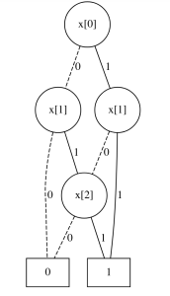
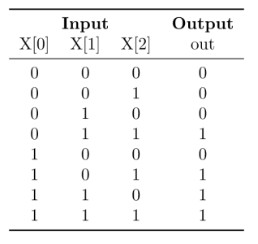
Recap: Binary Decision Diagram
6/
Notes:
If both x[0] and x[1] are 0 then the solution is 0, so the edge goes directly to the 0.
The other path to reach the 0 is with 0, 1, 0.
This reduction of possible paths lead to a much smaller representation then a truth table.
It is possible to compute and analyze BDD automatically. This includes checking for satisfiability, tautologies, and value inserting.
The complexity only grows either linear or quadratic with the number of inputs for these operations. (Exact numbers in “An Introduction to BDDs” by Henrik Reif Andersen).
With this technique, the analyzes can be done in an efficient way.

Slide 7
What’s New
BDD generation
Worst case error analysis (partly) finished
Area and power analysis of the VHDL design
7/

Slide 8
Generating BDD for a 2 bit adder
Generate outputs for exact and approx. adder
00 + 00 = approx: 010, exact: 000
00 + 01 = approx: 101, exact: 001
00 + 10 = approx: 100, exact: 010
00 + 11 = approx: 011, exact: 011
01 + 00 = approx: 101, exact: 001
01 + 01 = approx: 010, exact: 010
01 + 10 = approx: 011, exact: 011
…
8/
Notes:
If both x[0] and x[1] are 0 then the solution is 0, so the edge goes directly to the 0.
The other path to reach the 0 is with 0, 1, 0.
This reduction of possible paths lead to a much smaller representation then a truth table.
It is possible to compute and analyze BDD automatically. This includes checking for satisfiability, tautologies, and value inserting.
The complexity only grows either linear or quadratic with the number of inputs for these operations. (Exact numbers in “An Introduction to BDDs” by Henrik Reif Andersen).
With this technique, the analyzes can be done in an efficient way.

Slide 9
Generating BDD for a 2 bit adder
Generate outputs for exact and approx. adder
Calculate error
00 + 00 = approx: 010, exact: 000, error: 1
00 + 01 = approx: 101, exact: 001, error: 1
00 + 10 = approx: 100, exact: 010, error: 1
00 + 11 = approx: 011, exact: 011, error: 0
01 + 00 = approx: 101, exact: 001, error: 1
01 + 01 = approx: 010, exact: 010, error: 0
01 + 10 = approx: 011, exact: 011, error: 0
...
9/
Notes:
If both x[0] and x[1] are 0 then the solution is 0, so the edge goes directly to the 0.
The other path to reach the 0 is with 0, 1, 0.
This reduction of possible paths lead to a much smaller representation then a truth table.
It is possible to compute and analyze BDD automatically. This includes checking for satisfiability, tautologies, and value inserting.
The complexity only grows either linear or quadratic with the number of inputs for these operations. (Exact numbers in “An Introduction to BDDs” by Henrik Reif Andersen).
With this technique, the analyzes can be done in an efficient way.

Slide 10
Generating BDD for a 2 bit adder
Generate outputs for exact and approx. adder
Calculate error
Extract truth tables
00 + 00 = approx: 010, exact: 000, error: 1
00 + 01 = approx: 101, exact: 001, error: 1
00 + 10 = approx: 100, exact: 010, error: 1
00 + 11 = approx: 011, exact: 011, error: 0
01 + 00 = approx: 101, exact: 001, error: 1
01 + 01 = approx: 010, exact: 010, error: 0
01 + 10 = approx: 011, exact: 011, error: 0
...
bit 0
10/
Notes:
If both x[0] and x[1] are 0 then the solution is 0, so the edge goes directly to the 0.
The other path to reach the 0 is with 0, 1, 0.
This reduction of possible paths lead to a much smaller representation then a truth table.
It is possible to compute and analyze BDD automatically. This includes checking for satisfiability, tautologies, and value inserting.
The complexity only grows either linear or quadratic with the number of inputs for these operations. (Exact numbers in “An Introduction to BDDs” by Henrik Reif Andersen).
With this technique, the analyzes can be done in an efficient way.

Slide 11
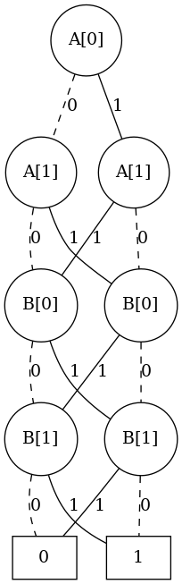
Generating BDD for a 2 bit adder
Generate outputs for exact and approx. adder
Calculate error
Extract truth tables
Draw for bits
00 + 00 = approx: 010, exact: 000, error: 1
00 + 01 = approx: 101, exact: 001, error: 1
00 + 10 = approx: 100, exact: 010, error: 1
00 + 11 = approx: 011, exact: 011, error: 0
01 + 00 = approx: 101, exact: 001, error: 1
01 + 01 = approx: 010, exact: 010, error: 0
01 + 10 = approx: 011, exact: 011, error: 0
...
bit 0
11/
Notes:
If both x[0] and x[1] are 0 then the solution is 0, so the edge goes directly to the 0.
The other path to reach the 0 is with 0, 1, 0.
This reduction of possible paths lead to a much smaller representation then a truth table.
It is possible to compute and analyze BDD automatically. This includes checking for satisfiability, tautologies, and value inserting.
The complexity only grows either linear or quadratic with the number of inputs for these operations. (Exact numbers in “An Introduction to BDDs” by Henrik Reif Andersen).
With this technique, the analyzes can be done in an efficient way.

Slide 12
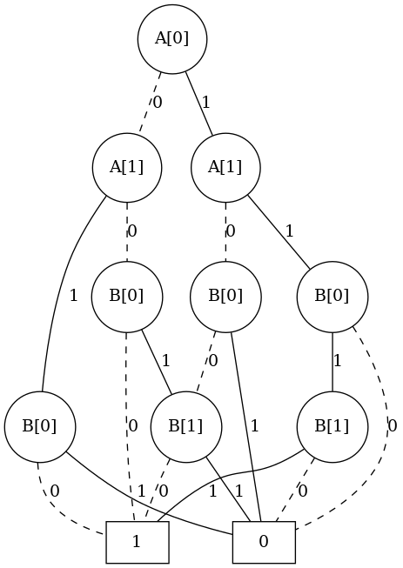
Generating BDD for a 2 bit adder
Generate outputs for exact and approx. adder
Calculate error
Extract truth tables
Draw BDD for bits
Draw BDD for error
00 + 00 = approx: 010, exact: 000, error: 1
00 + 01 = approx: 101, exact: 001, error: 1
00 + 10 = approx: 100, exact: 010, error: 1
00 + 11 = approx: 011, exact: 011, error: 0
01 + 00 = approx: 101, exact: 001, error: 1
01 + 01 = approx: 010, exact: 010, error: 0
01 + 10 = approx: 011, exact: 011, error: 0
...
error
12/
Notes:
If both x[0] and x[1] are 0 then the solution is 0, so the edge goes directly to the 0.
The other path to reach the 0 is with 0, 1, 0.
This reduction of possible paths lead to a much smaller representation then a truth table.
It is possible to compute and analyze BDD automatically. This includes checking for satisfiability, tautologies, and value inserting.
The complexity only grows either linear or quadratic with the number of inputs for these operations. (Exact numbers in “An Introduction to BDDs” by Henrik Reif Andersen).
With this technique, the analyzes can be done in an efficient way.

Slide 13
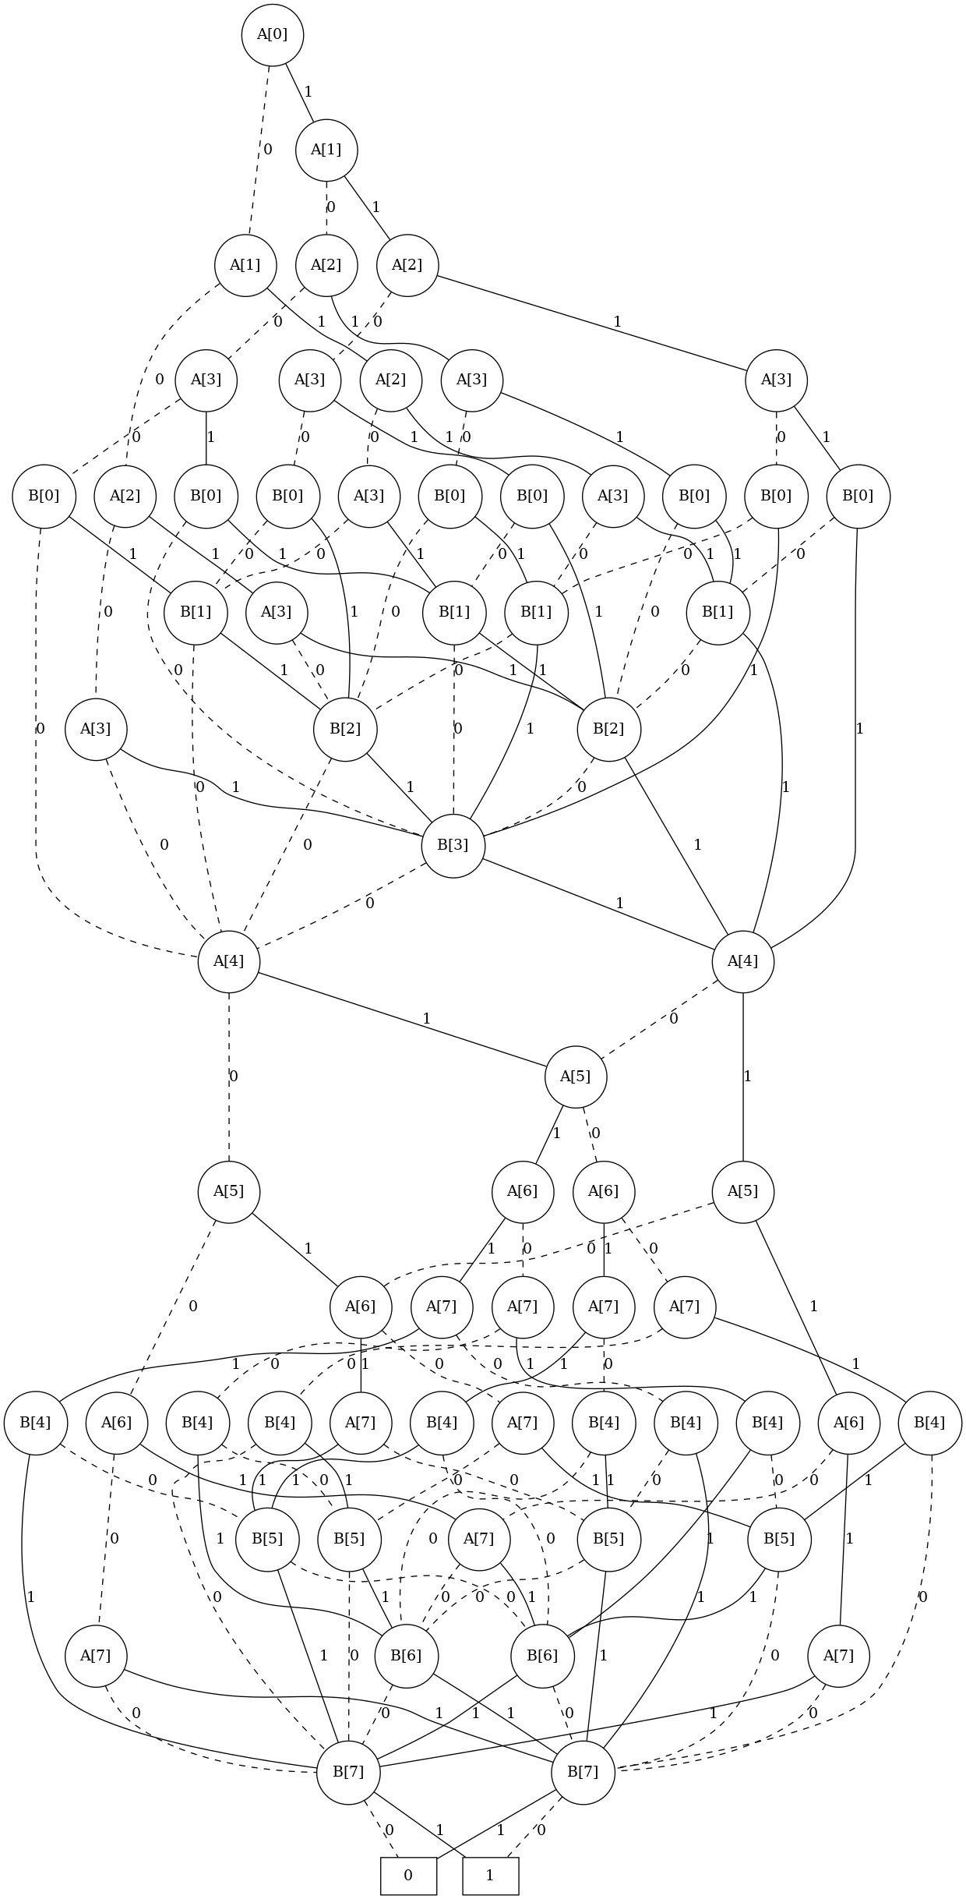
BDD: Complexity
Example:
* 8 bit full adder
* 2^(8*2) = 65536 input combinations
* BDDs for output bit „1“
← Approximate: 31 nodes
Exact: 49 nodes →
13/
Notes:
If both x[0] and x[1] are 0 then the solution is 0, so the edge goes directly to the 0.
The other path to reach the 0 is with 0, 1, 0.
This reduction of possible paths lead to a much smaller representation then a truth table.
It is possible to compute and analyze BDD automatically. This includes checking for satisfiability, tautologies, and value inserting.
The complexity only grows either linear or quadratic with the number of inputs for these operations. (Exact numbers in “An Introduction to BDDs” by Henrik Reif Andersen).
With this technique, the analyzes can be done in an efficient way.

Slide 14
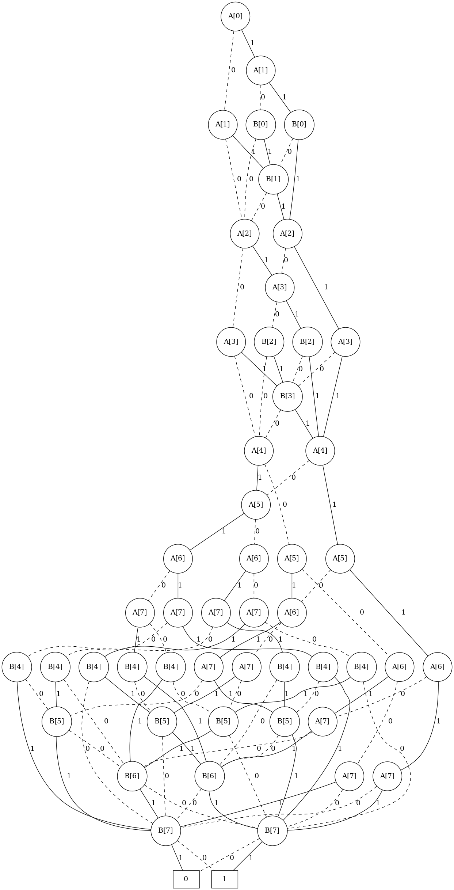
BDD: Complexity
Example:
* 8 bit full adder
* 2^(8*2) = 65536 input combinations
* BDDs for output bit „1“
← Approximate: 31 nodes
Exact: 49 nodes →
* 64 bit adder ?
* 2^(64*2) = 3.4E38 input combinations
14/
Notes:
If both x[0] and x[1] are 0 then the solution is 0, so the edge goes directly to the 0.
The other path to reach the 0 is with 0, 1, 0.
This reduction of possible paths lead to a much smaller representation then a truth table.
It is possible to compute and analyze BDD automatically. This includes checking for satisfiability, tautologies, and value inserting.
The complexity only grows either linear or quadratic with the number of inputs for these operations. (Exact numbers in “An Introduction to BDDs” by Henrik Reif Andersen).
With this technique, the analyzes can be done in an efficient way.

Slide 15
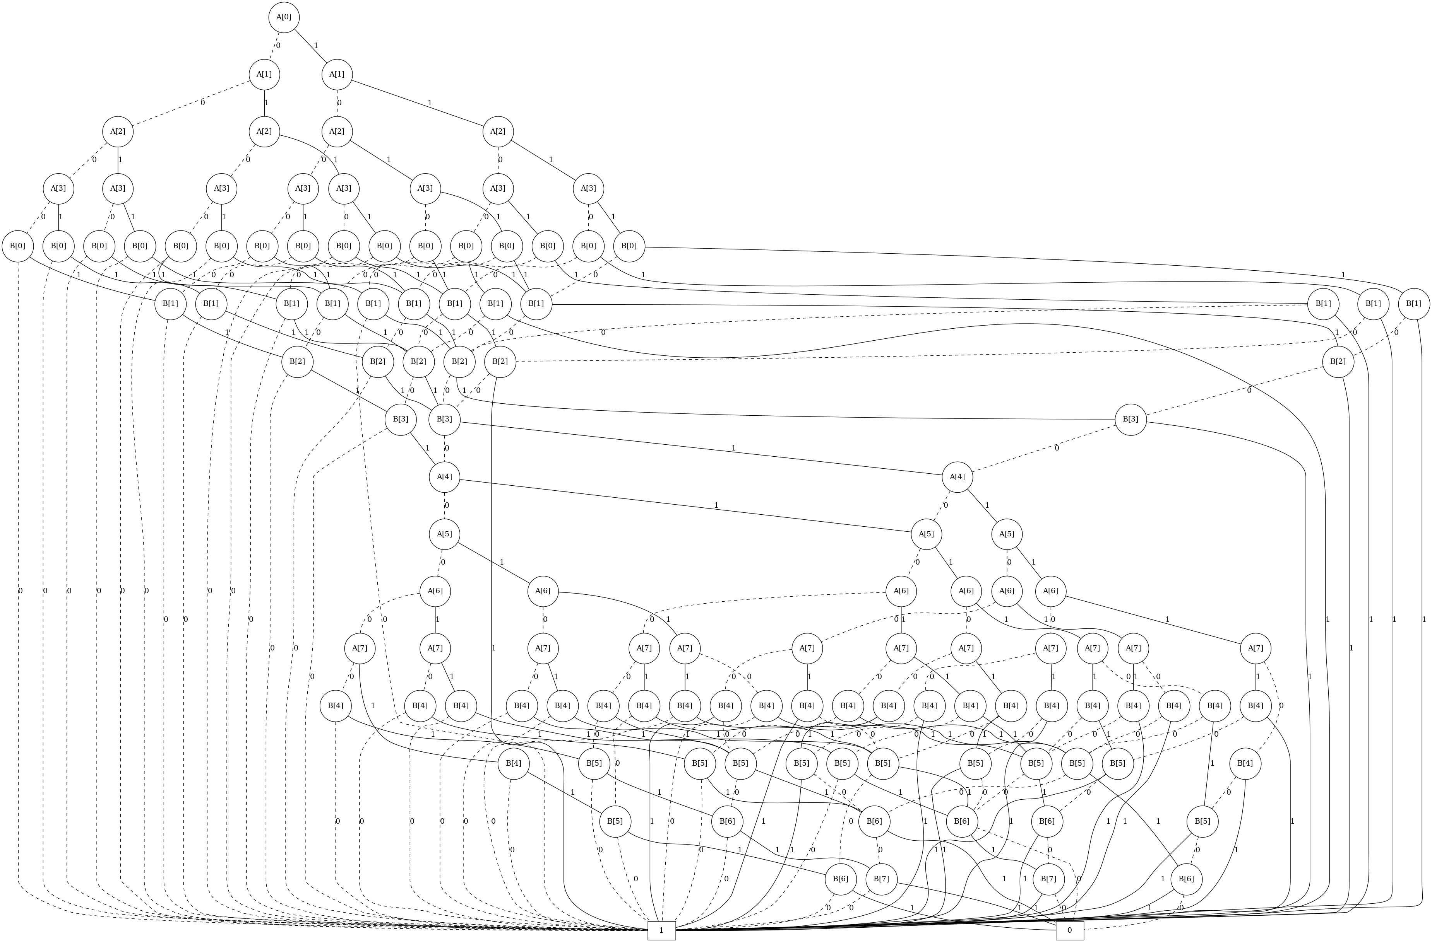
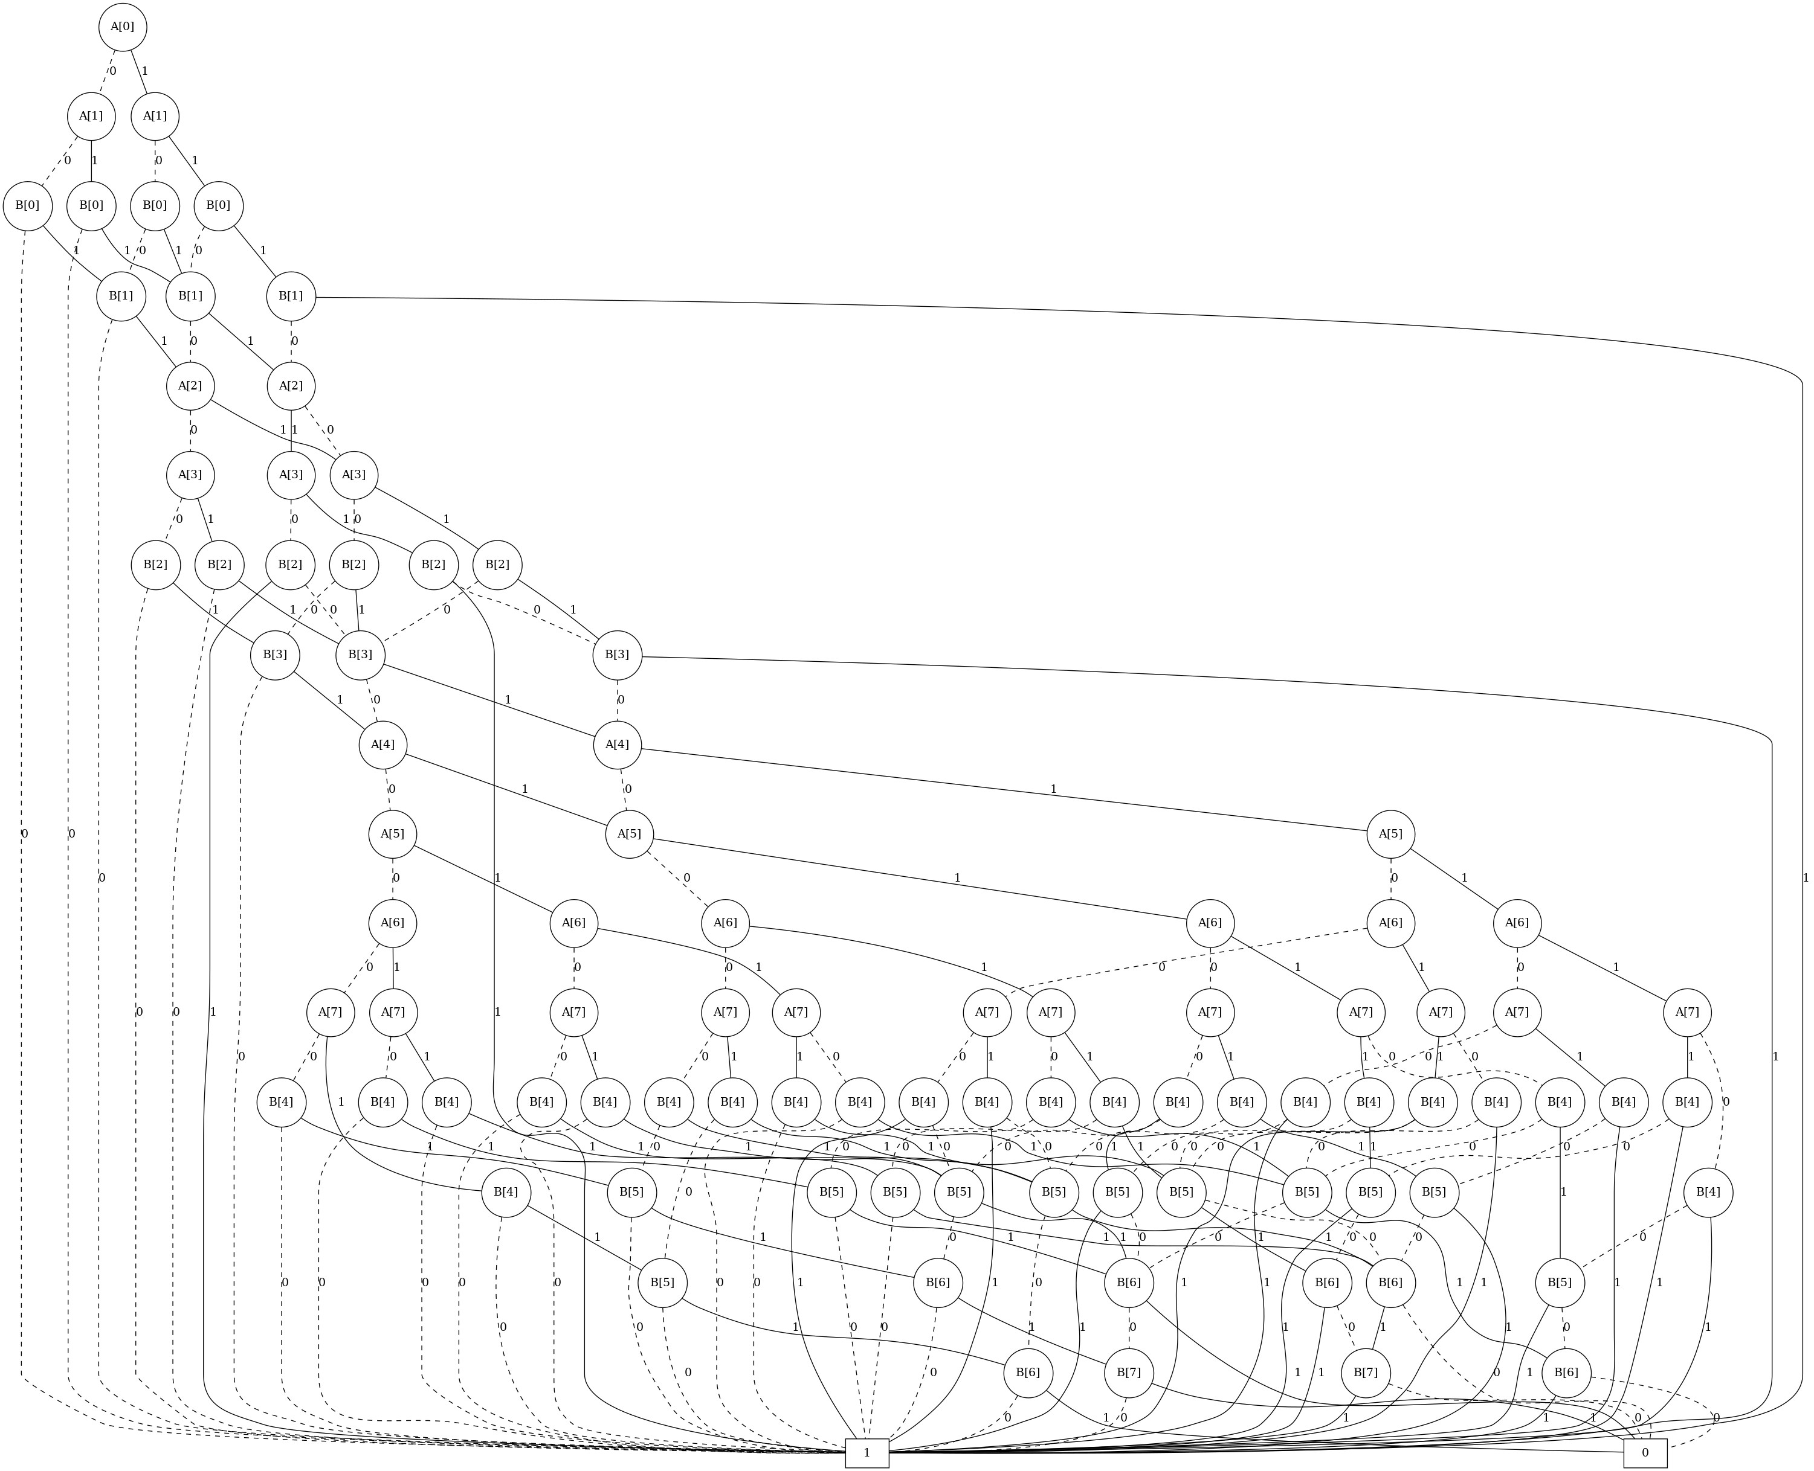
BDD: Error
* Error BDD for 8 bit adders
15/
Notes:
If both x[0] and x[1] are 0 then the solution is 0, so the edge goes directly to the 0.
The other path to reach the 0 is with 0, 1, 0.
This reduction of possible paths lead to a much smaller representation then a truth table.
It is possible to compute and analyze BDD automatically. This includes checking for satisfiability, tautologies, and value inserting.
The complexity only grows either linear or quadratic with the number of inputs for these operations. (Exact numbers in “An Introduction to BDDs” by Henrik Reif Andersen).
With this technique, the analyzes can be done in an efficient way.

Slide 16
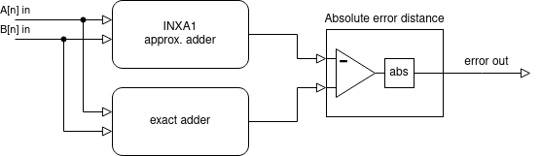
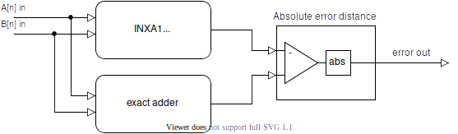
BDD: Error Analysis
00 + 00 = approx: 010, exact: 000, error out: 2
00 + 01 = approx: 101, exact: 001, error out: 4
00 + 10 = approx: 100, exact: 010, error out: 2
00 + 11 = approx: 011, exact: 011, error out: 0
01 + 00 = approx: 101, exact: 001, error out: 4
01 + 01 = approx: 010, exact: 010, error out: 0
01 + 10 = approx: 011, exact: 011, error out: 0
...
Adapted from: Z. Vasicek: Formal Methods for Exact Analysis of Approximate Circuits
16/
Notes:
If both x[0] and x[1] are 0 then the solution is 0, so the edge goes directly to the 0.
The other path to reach the 0 is with 0, 1, 0.
This reduction of possible paths lead to a much smaller representation then a truth table.
It is possible to compute and analyze BDD automatically. This includes checking for satisfiability, tautologies, and value inserting.
The complexity only grows either linear or quadratic with the number of inputs for these operations. (Exact numbers in “An Introduction to BDDs” by Henrik Reif Andersen).
With this technique, the analyzes can be done in an efficient way.

Slide 17



BDD: Error Analysis
2 bit adder
A in
00 01 10 11
00
01
10
11
Error distance
0
2
4
B in
17/
Notes:
If both x[0] and x[1] are 0 then the solution is 0, so the edge goes directly to the 0.
The other path to reach the 0 is with 0, 1, 0.
This reduction of possible paths lead to a much smaller representation then a truth table.
It is possible to compute and analyze BDD automatically. This includes checking for satisfiability, tautologies, and value inserting.
The complexity only grows either linear or quadratic with the number of inputs for these operations. (Exact numbers in “An Introduction to BDDs” by Henrik Reif Andersen).
With this technique, the analyzes can be done in an efficient way.

Slide 18
VHDL in Detail
What has been done so far:
1-, 4-, 8- and 16-bit full adders in exact and approximate form are completed
Schematics regarding these designs are realised
Area and power analysis of the VHDL design are partially done
18/

Slide 19
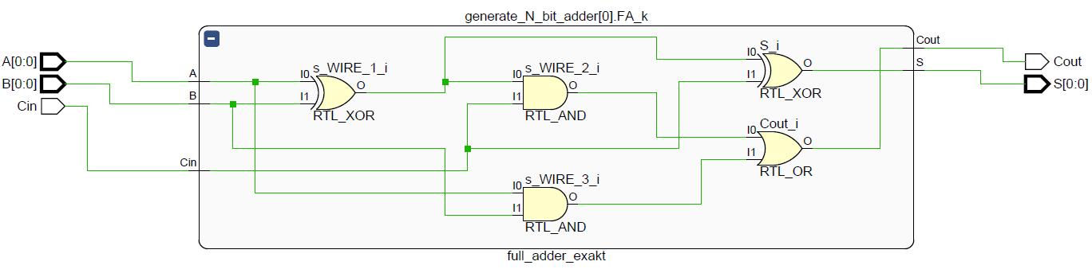
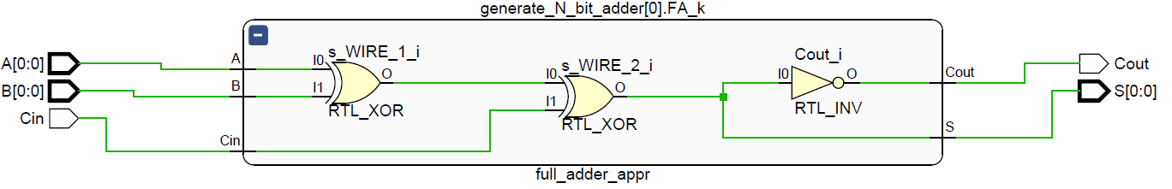
VHDL: Schematics
Exact vs. Approximate: reduced basic logic gate number
1-Bit Full Adder:
1-Bit Approximate Full Adder (INXA1):
19/
Notes:
What we have here is an elaborated design of our VHDL code automatically generated by Vivado.
As you can see; 1 Bit exact full adder has 2 XOR, 2 AND and 1 OR gate. On the other hand in approximate design (INXA1) we have 2 XOR and 1 NOT gate intact.
Bear in mind that XOR gate is consist of 1 AND, 1 NAND and 1 OR gate. Which is equivalent to 4 basic gates in total.

Slide 20
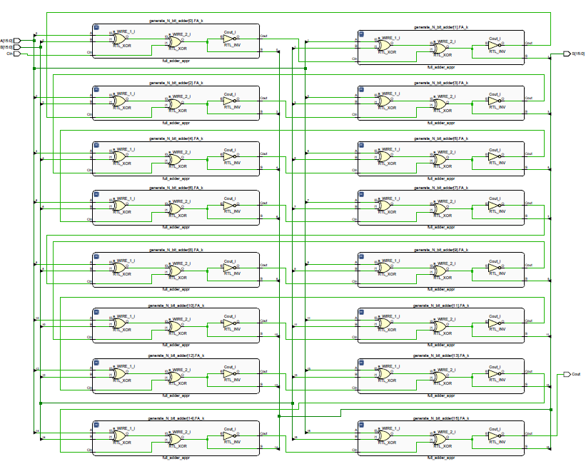
16 Bit Approximate Adder
Notes:
To have a rough idea, here is how 16 bit approximate full adder looks like.
It‘s basicly multiplying 1 bit adder with the given bit number.
All these designs are asynchronous, meaning without any clocks. Once we add clocks, cycles the complexity will be much higher.

Slide 21
Area Analysis
Used metric for area: Gate Count in adders
TYPE | XOR | OR | AND | NOT | Basic Gates in Total
1 Bit Exact | 2 | 1 | 2 | X | 11
4 Bit Exact | 8 | 4 | 8 | X | 44
8 Bit Exact | 16 | 8 | 16 | X | 88
16 Bit Exact | 32 | 16 | 32 | X | 176
1 Bit Appro. | 2 | X | X | 1 | 9 (-3)
4 Bit Appro. | 8 | X | X | 4 | 36 (-8)
8 Bit Appro. | 16 | X | X | 8 | 72 (-16)
16 Bit Appro. | 32 | X | X | 16 | 144 (-32)
= ~18.2% less
XOR = 2 AND + 1 OR + 1 NOT = 4 Basic Gates
21/
Notes:
This is still in early stage. But basically what we initially thought is that gate count number is a good indicator for how much space we can actually save.
Before the demo presentation i‘m thinking to expand these area and power analysis sections with more detail.
And for that we can use for example; Synopsys Design compiler. With these Design Compiler we will have more precise number in analysis.

Slide 22
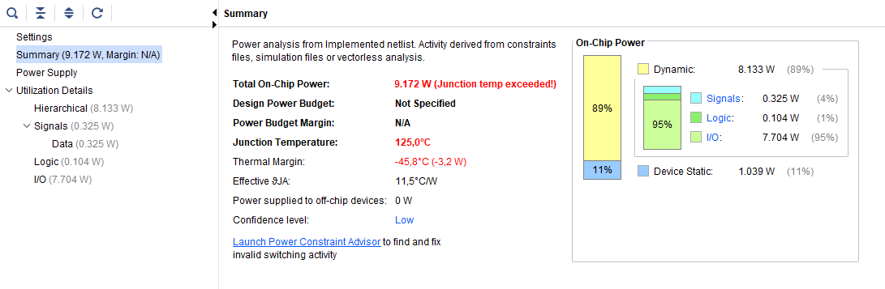
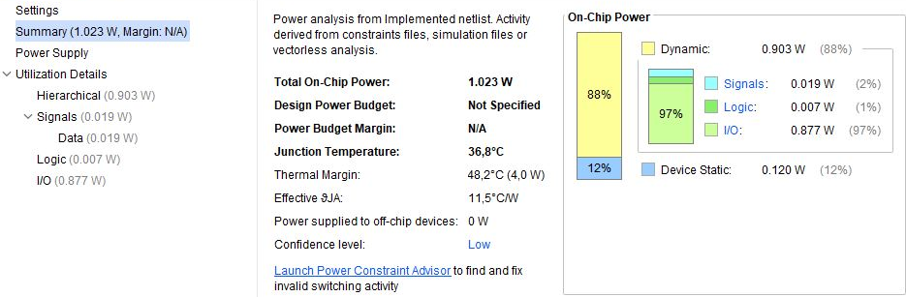
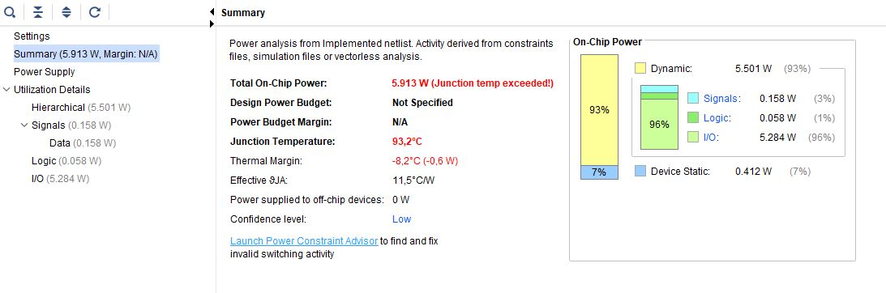
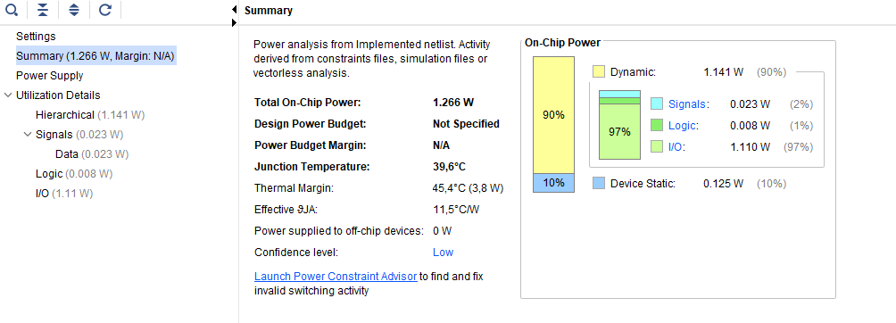
Power Analysis
1 BIT
Exact Adder
Approximate Adder
EXACT
APPROXIMATE
22/
Notes:
Power analysis is done by Vivado‘s power analysis tool with default settings.
What‘s really problematic here is that approximate design should be more efficient than exact design. But what we see here is the opposite.
Approximate design consumes 23.75% more power.

Slide 23
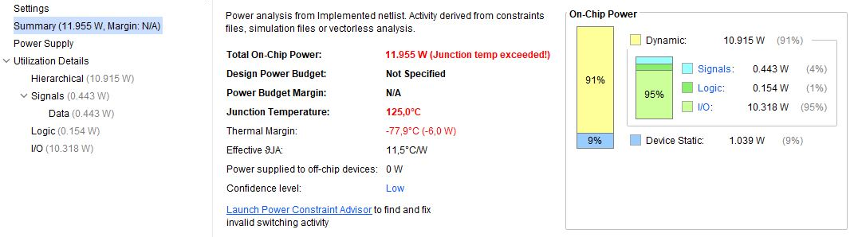
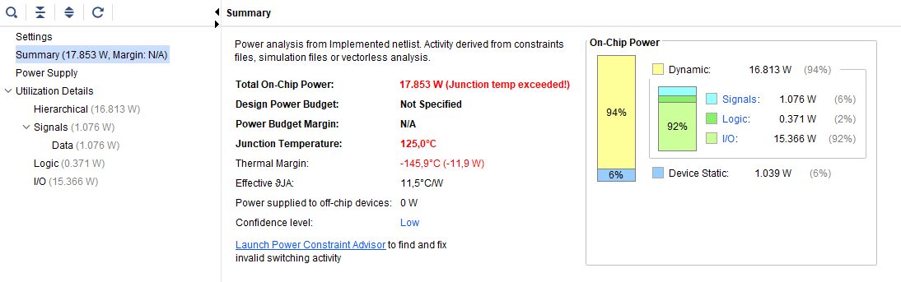
Power Analysis
16 BIT
EXACT
APPROXIMATE
23/
Notes:
In 16 Bit design, the difference in power consumption reaches to almost 50% (49.33%).

Slide 24
Problem in Power Analysis
What could be the reason:
Approximate design is actually faster in calculating inputs.
Therefore, in given certain amount of time it processes more calculations, which leads to more power consumption.
Without a Testbench we don‘t have a controlled test environment.
Vivado is sometimes inconsistent with its‘ analysis tools.
Signal Rate (Mtr/s) | A | B | Cin | S | Cout
16 Bit Exact | 12500 | 12500 | 12500 | 32304,17 | 19238,91
16 Bit Appro. | 12500 | 12500 | 12500 | 46986,90 | 49996,23
24/
Notes:
„Meridiantertie“ (1 mtr = 0,51444 Meter)
Without testbench we are actually blind to see what parameters vivado is actually taking into account.

Slide 25
Future Plans
Adding functionality for generic N bit Adders
Final Worst Case Error Analysis with BDD
Several Graphical Error Visualizations
Designing a Testbench for VHDL design
Implementing on Zedboard (Hardware)
25/

Slide 26
Thank you!
26/

